Slide 1

Web Application Testing
Toys Online Store
FINAL PROJECT

Slide 2
APP DESCRIPTION
Toys Online Store
Web application
Online store for toys, books and school materials
National shipping

Slide 3
TESTING APPROACH
Smoke Testing design and execution to assess whether the main functions of the application appear to work correctly
Exploratory testing for the main functionalities of the application
Documenting the Exploratory testing and record the identified bugs so they can be further replicated
Performing additional types of testing such as: Ad-hoc, UI, Compatibility, Positive, Negative, Usability, Compatibility
Thorough exploration and further testing performed on sections of the application where bugs were identified
Writing the Test Report

Slide 4

TOOLS USED
Mantis Bug Tracker for bug reporting
MS Excel for test case management
Snipping Tool for screenshots capture
Guerrilla Mail for disposable temporary e-mail addresses
Xmind Tool for mind maps

Slide 5
TESTING TYPES COVERED
Smoke Testing
Ad-hoc Testing
Positive Testing
Exploratory Testing
Negative Testing
UI Testing
Usability Testing
Compatibility Testing

Slide 6
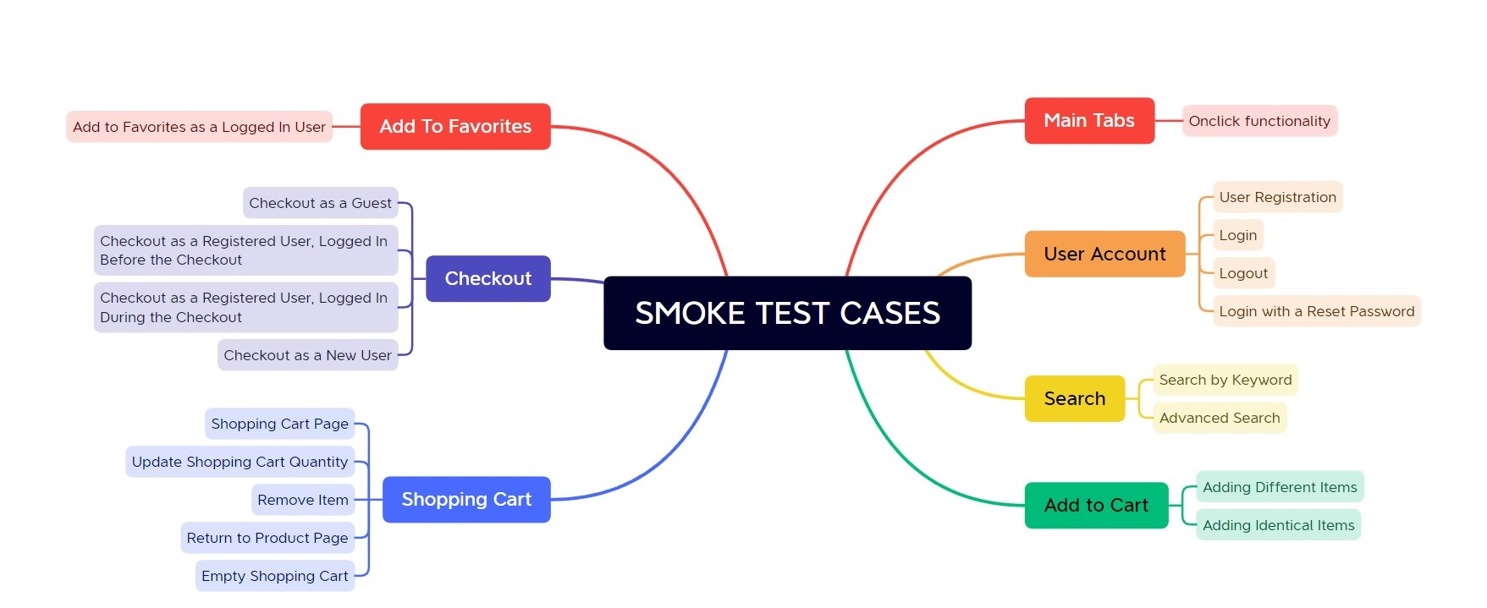
TEST CASES OVERVIEW

Slide 7
BUGS OVERVIEW

Slide 8
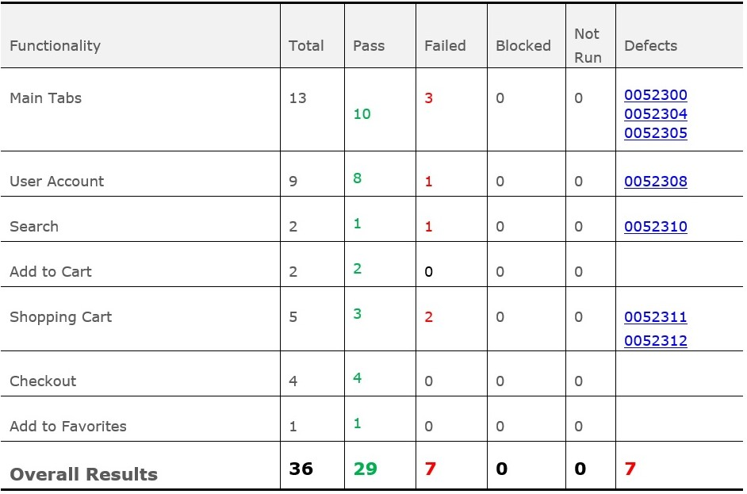
TEST CASES RESULTS

Slide 9
CONCLUSIONS
The main functionalities of the website were tested during Smoke Testing sessions. From a total number of 36 smoke tests, 29 tests (82.26%) passed, and 7 tests (17.74%) failed. The failed test cases were related to the following functionalities: Main Tabs, User Account, Search and Shopping Cart.
1
In addition to Smoke Testing and Positive Testing, testing types such as Exploratory Testing, UI Testing, Compatibility Testing, Ad-hoc Testing, Negative Testing and Usability Testing were covered.
2
A total number of 27 new bugs were identified, the majority being identified during Exploratory and Negative Testing. 17 of the identified bugs have a major grade of severity, while the rest of 10 were considered of normal severity.
3
Most of the major severity bugs are related to key-functionalities of the website, such as User Account, Shopping Cart and Checkout.
4
Compatibility Testing was performed to test the website behaviour on different browsers and devices. While the bugs identified via Windows OS reproduced on all browsers, 2 user interface related bugs were identified via Android OS / mobile device (one of which was considered of major severity and the other of normal severity).
5
Considering the high number of bugs identified, most of which being related to key-functionalities of the website, fixing of at least the major severity bugs is strongly recommended, especially since the application is already in production.
6

Slide 10
LESSONS LEARNED
When no requirements are available, think how a real-life user would use the application
Keep the test documentation and bug reporting concise and easy to follow
Perform a thorough exploratory testing in order to fully understand the application functionalities
The complex sections of the application are usually prone to defects
After a deeper exploration of a certain area of the application, step out and look at the bigger picture: new areas worth exploring will become more visible

